Slide 1
Sky Islands Individual-Based Model
Completing the Sky Islands Model
Simulation movement/duplication of species points
Movement based on Sky Islands Model
Birth rate affected by age
Death rate affected by age and intraspecific competition
Moving forward
Eric Gibson

Slide 2
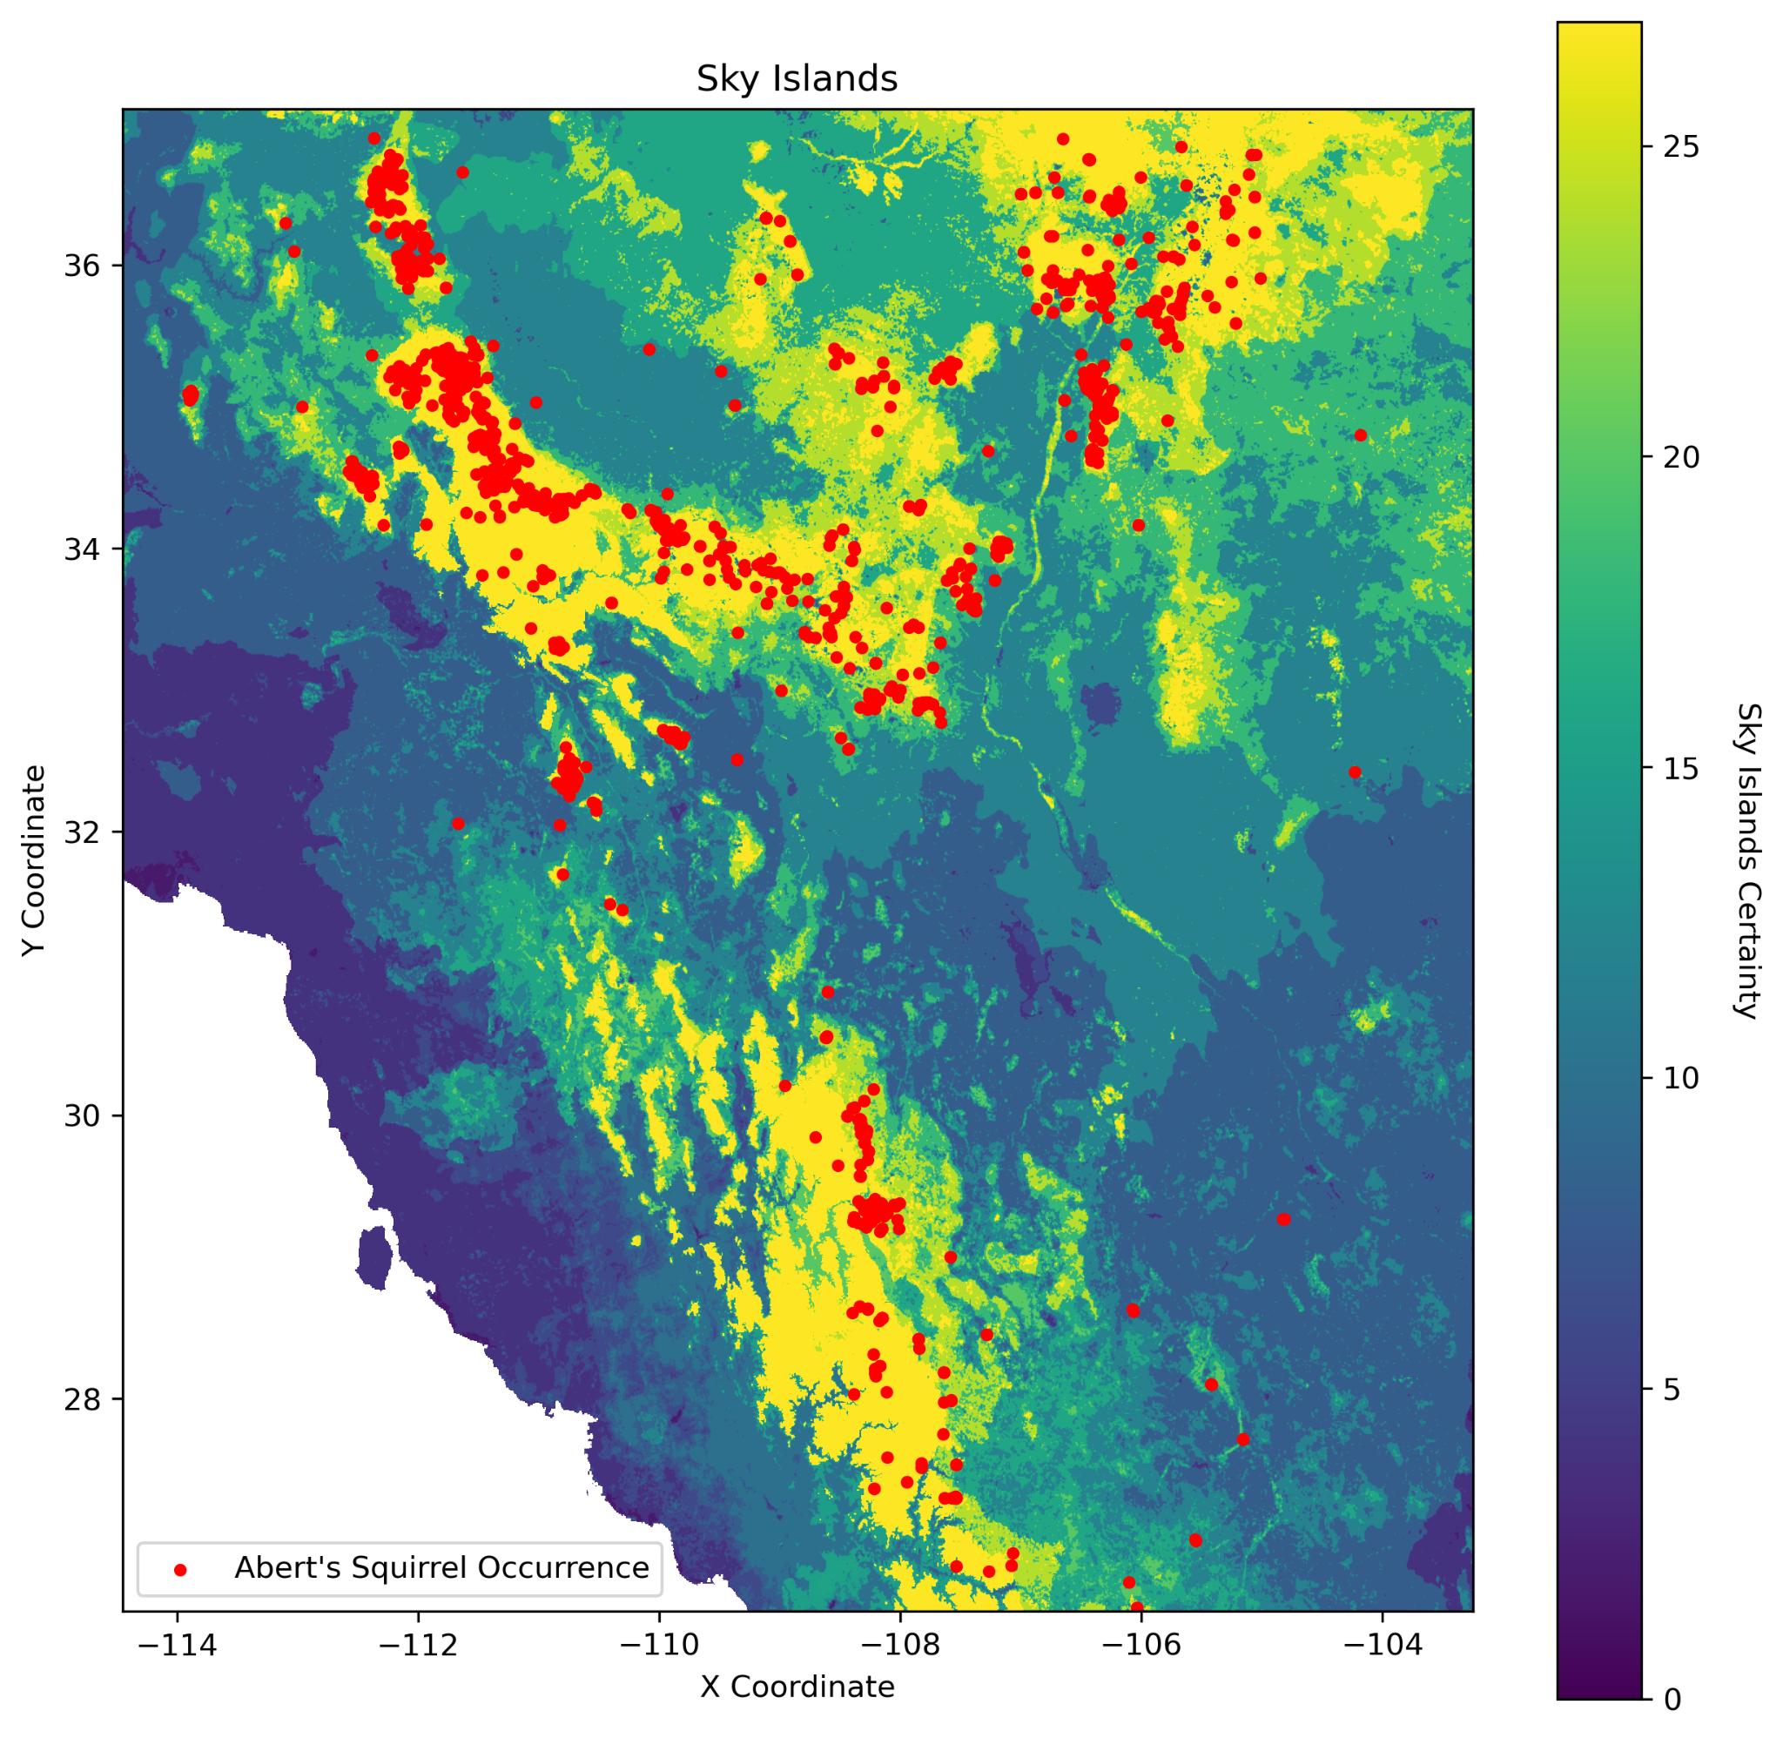
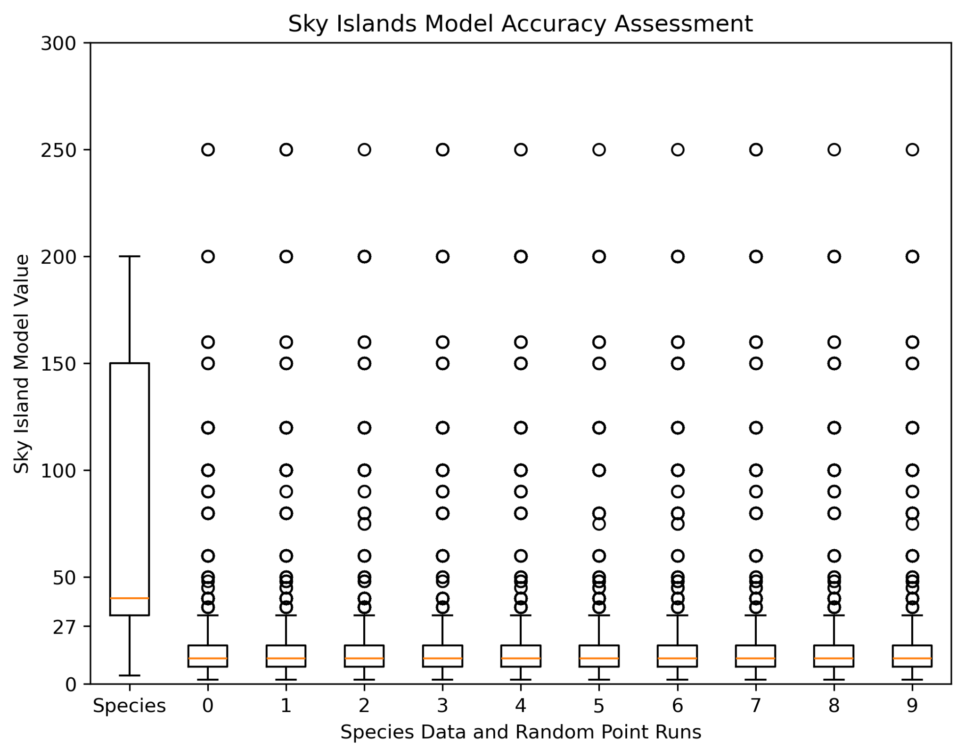
Sky Islands Model Completion
T-statistic: -702.43
P-value: >0.0001

Slide 3
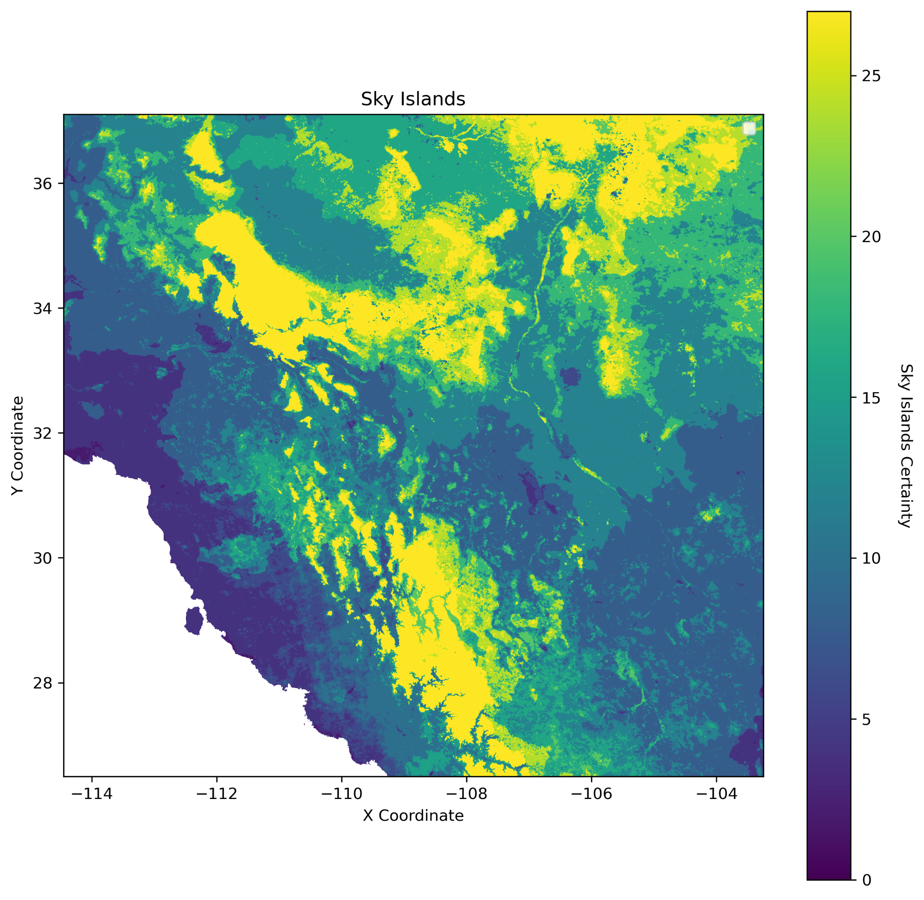
Today

Slide 4
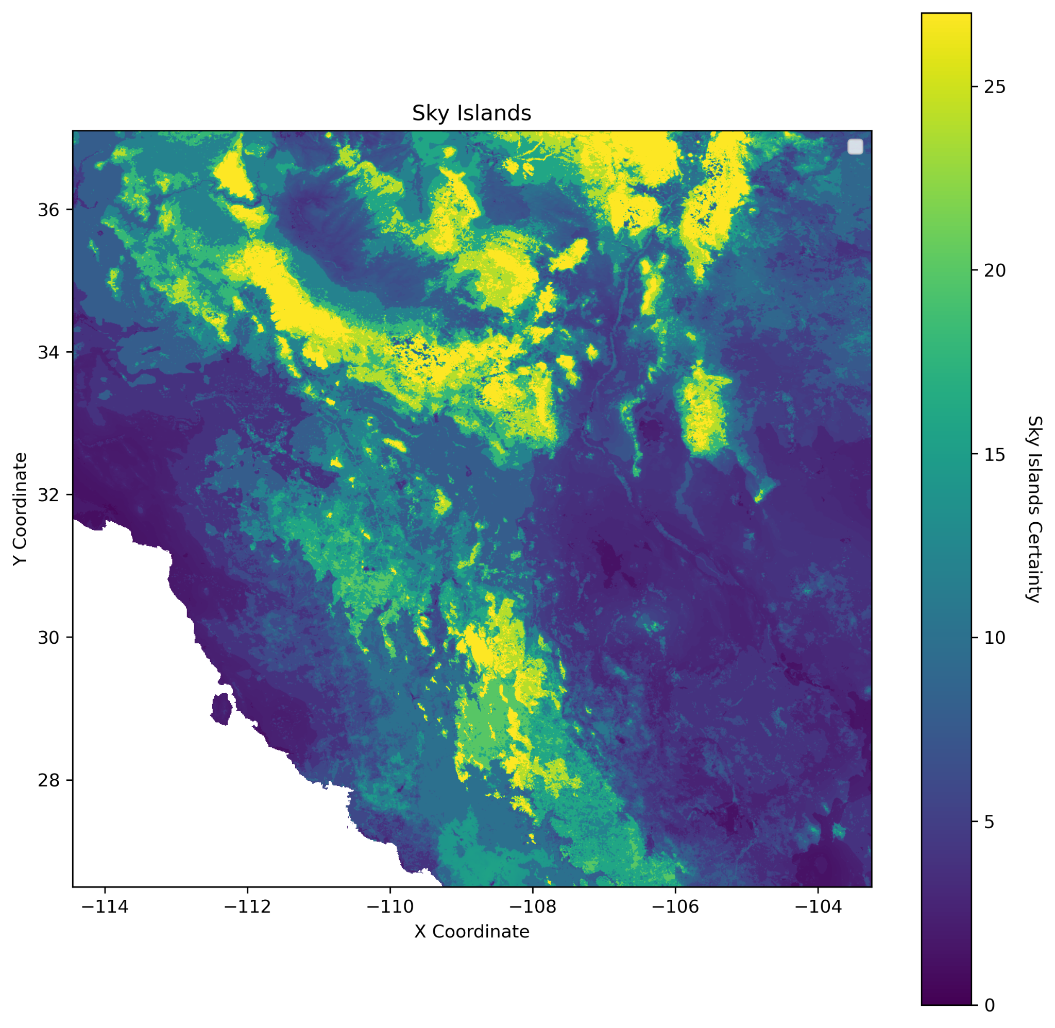
50 Years
Coe, Sharon J, et al. “Chapter 1: A Review of Historical Trends and Projections for Future Change of Climate and Vegetation.” An Assessment of Climate Change and the Vulnerability of Wildlife in the Sky Islands of the Southwest, USFS, Fort Collins, Colorado, 2012, pp. 1–12, doi.org/10.2737/RMRS-GTR-273. Accessed 25 Oct. 2024.

Slide 5
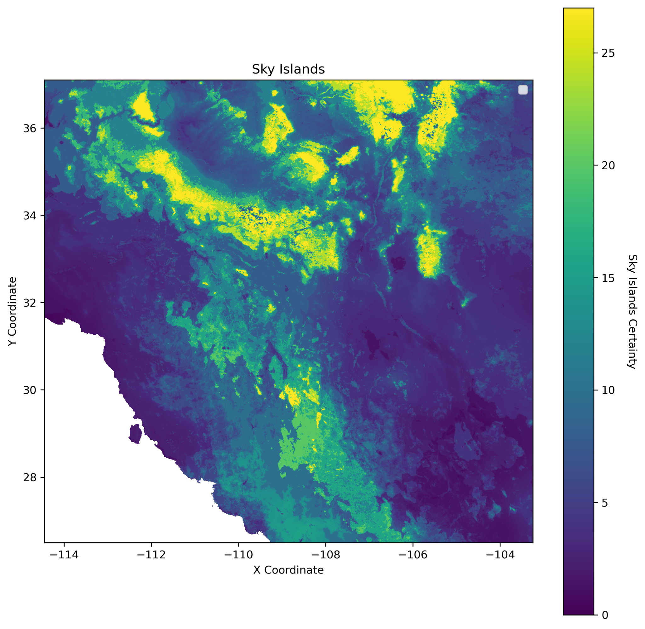
100 Years
Coe, Sharon J, et al. “Chapter 1: A Review of Historical Trends and Projections for Future Change of Climate and Vegetation.” An Assessment of Climate Change and the Vulnerability of Wildlife in the Sky Islands of the Southwest, USFS, Fort Collins, Colorado, 2012, pp. 1–12, doi.org/10.2737/RMRS-GTR-273. Accessed 25 Oct. 2024.

Slide 6
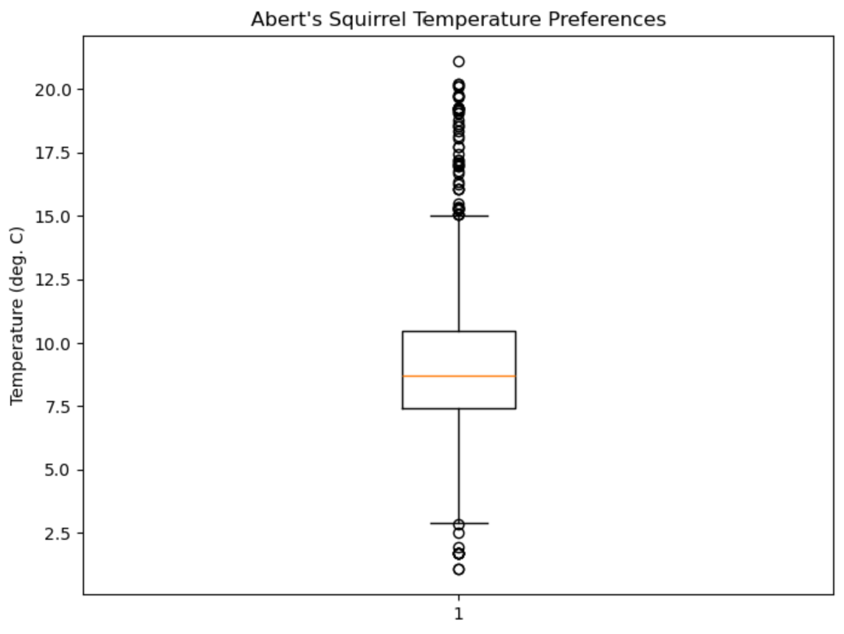
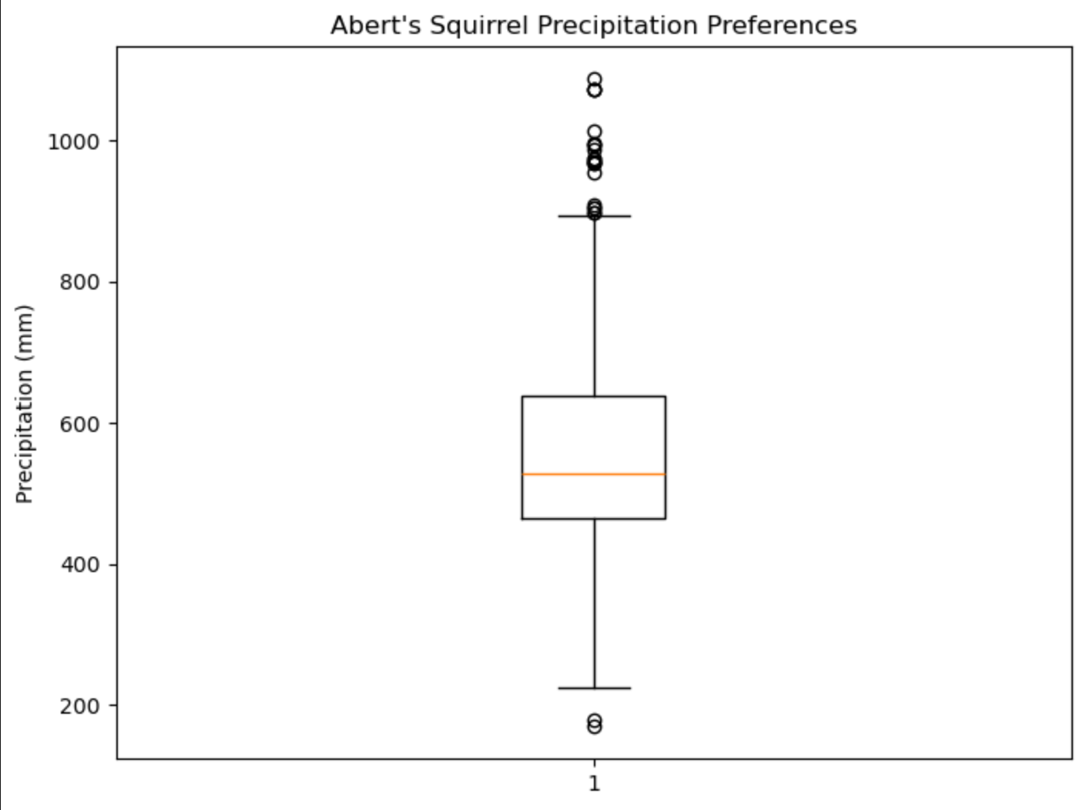
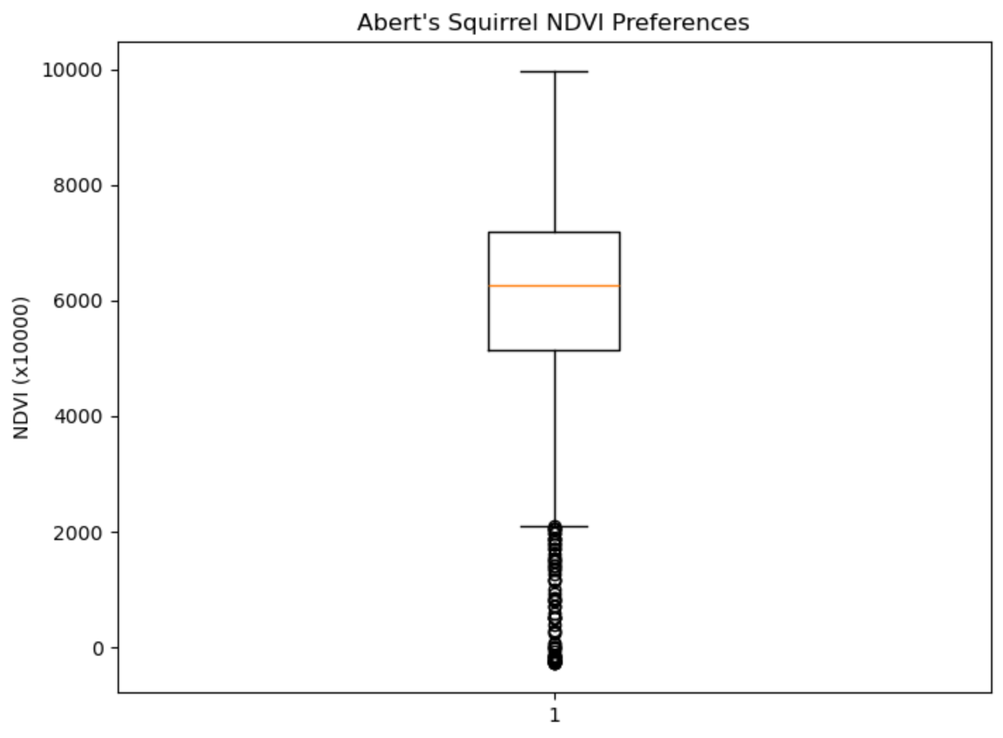
Abert’s Squirrel Preferences

Slide 7
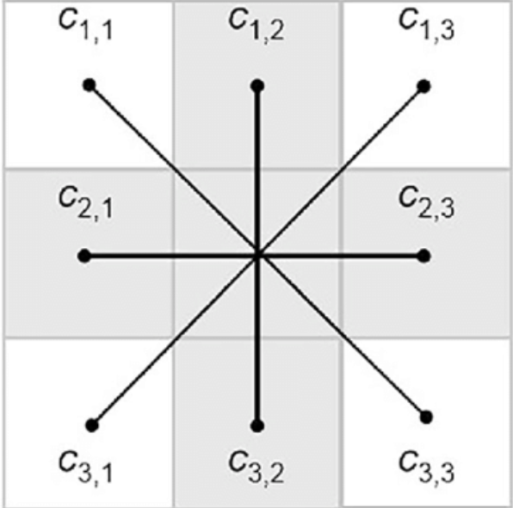
How Individuals Move
Value of the raster cell each point intersects is extracted
Values of each raster cell surrounding the cell mentioned above is extracted and the maximum value is found - RANDOMIZED!
Point then moves to this cell through a queen transformation (10x10)
More transformations per year will be done
Movement towards food sources will also be implemented
‹#›

Slide 8
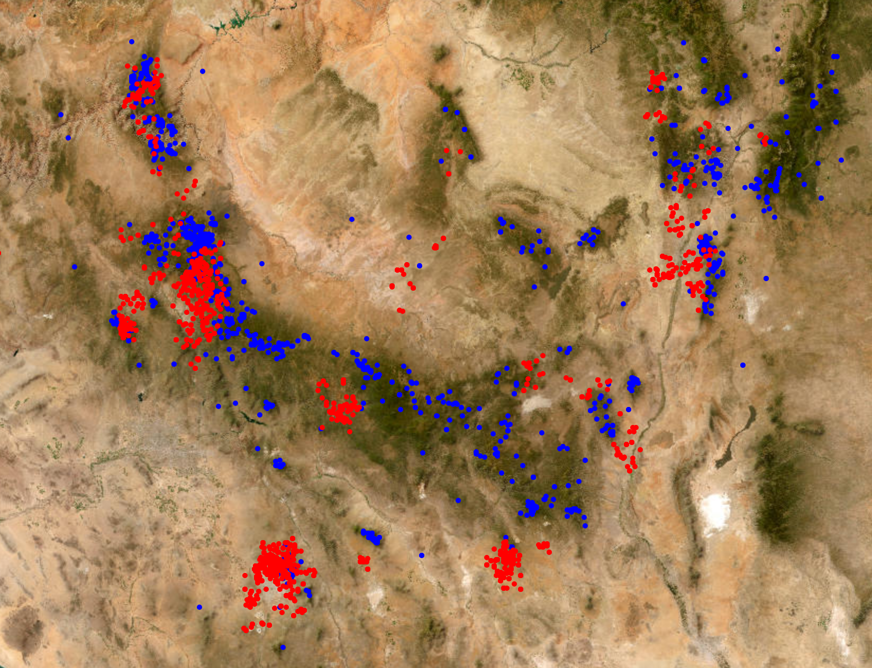
How Individuals Move
‹#›

Slide 9
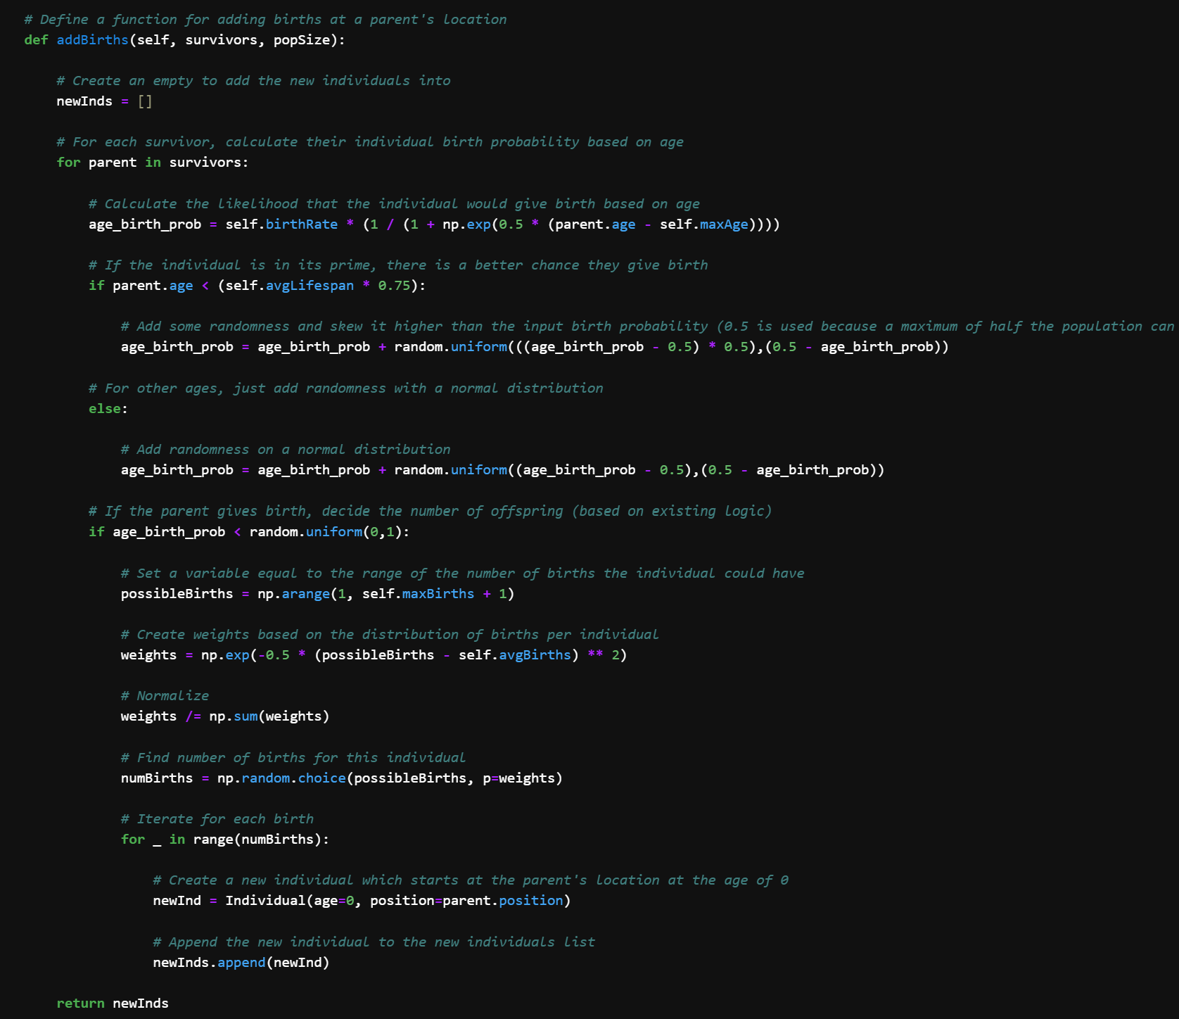
How Individuals are Born

Slide 10
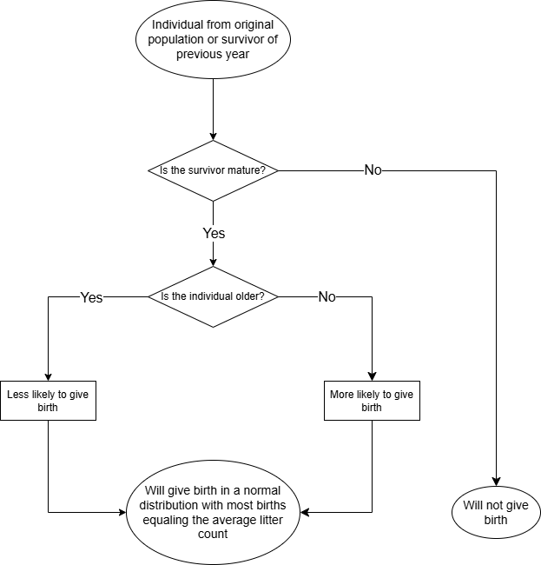
How Individuals are Born

Slide 11
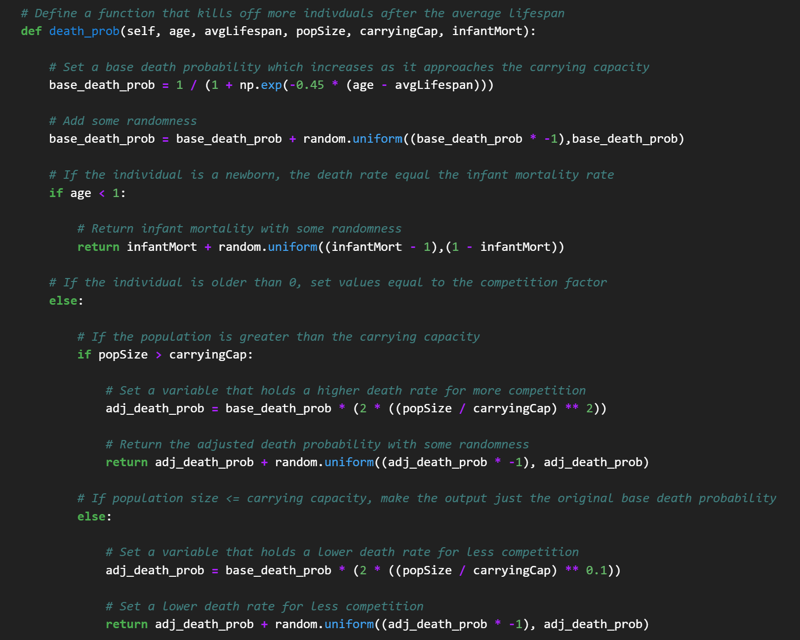
How Individuals Die

Slide 12
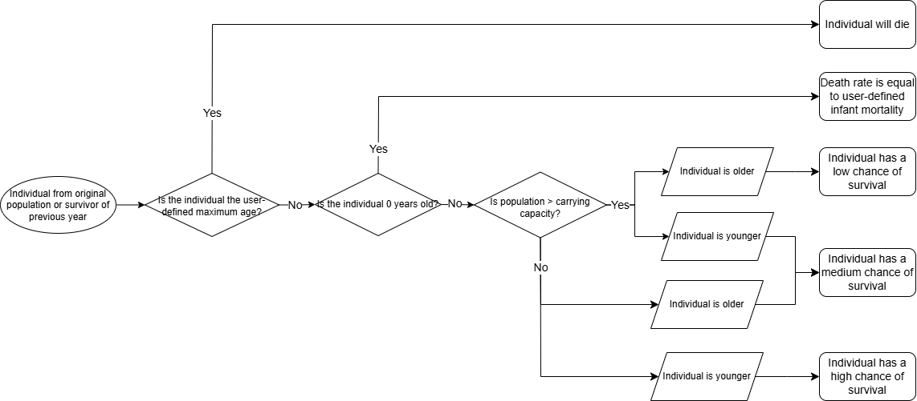
How Individuals Die

Slide 13
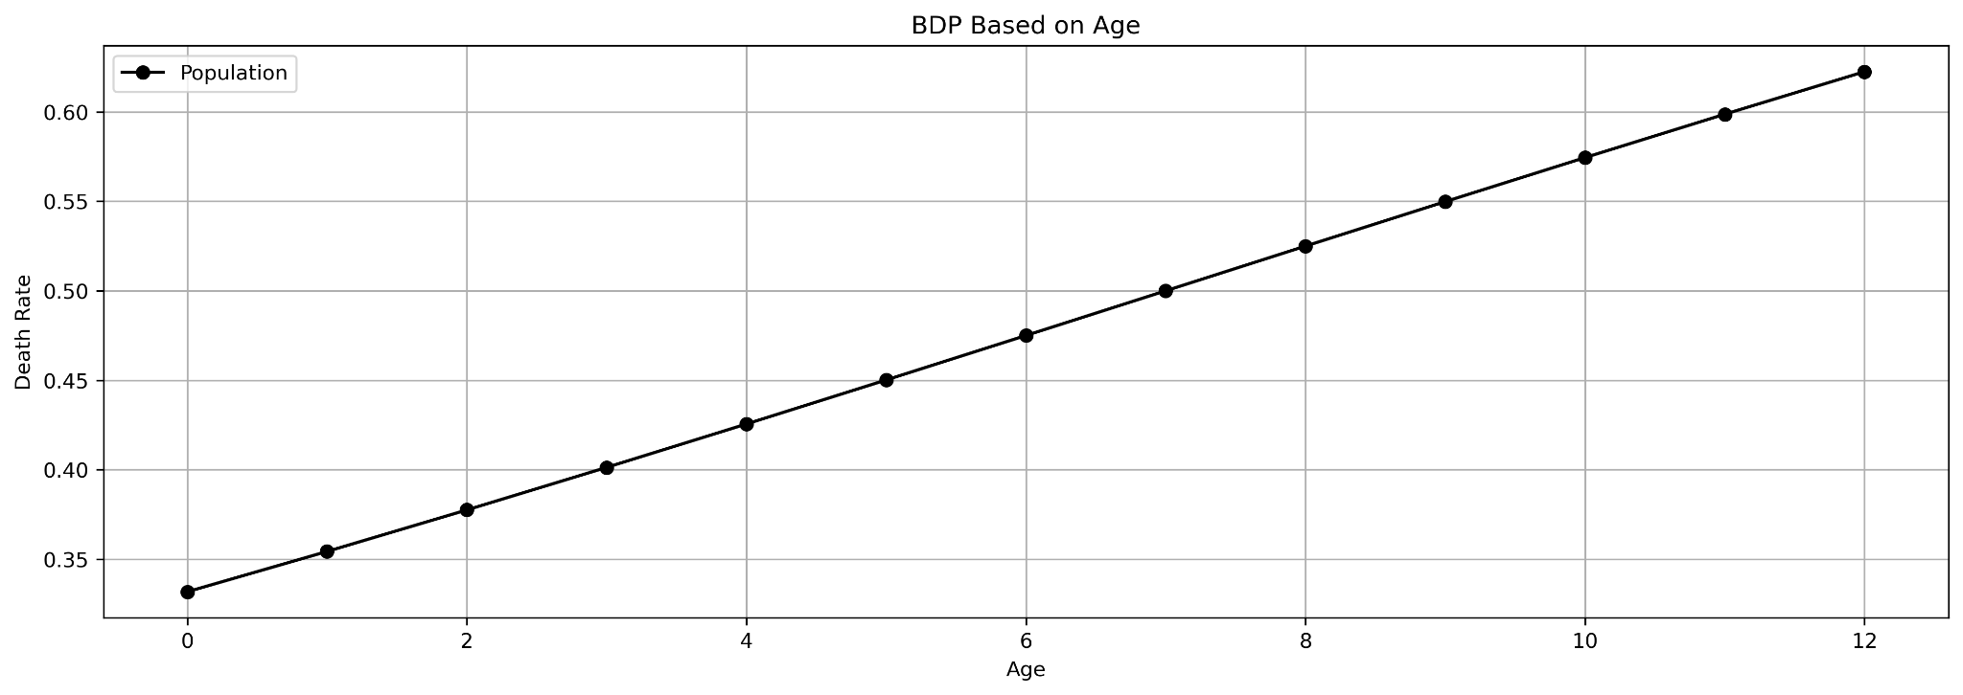
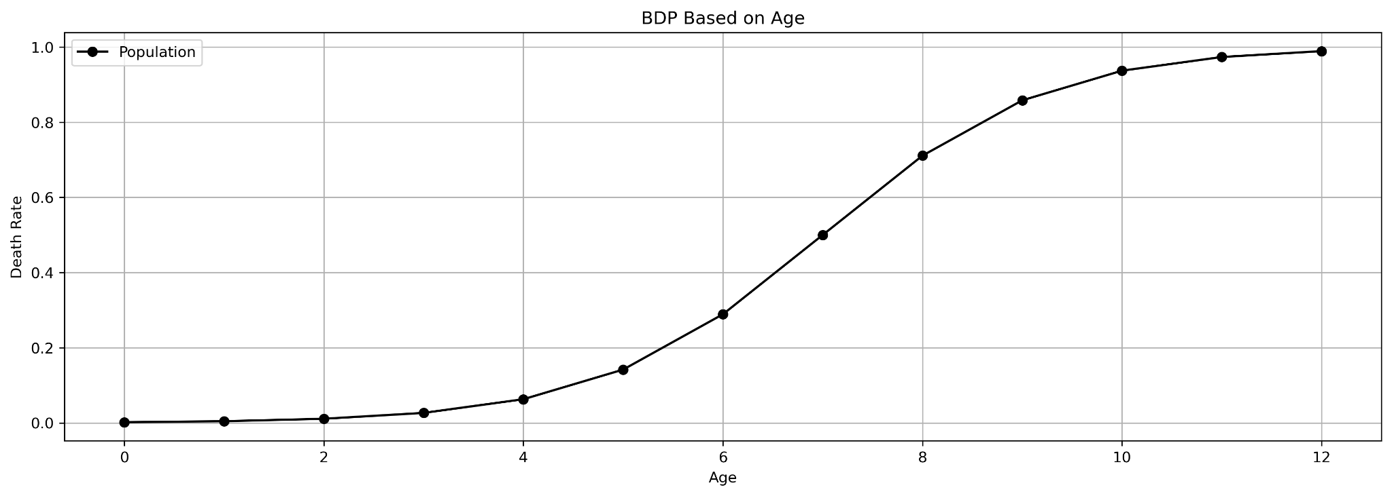
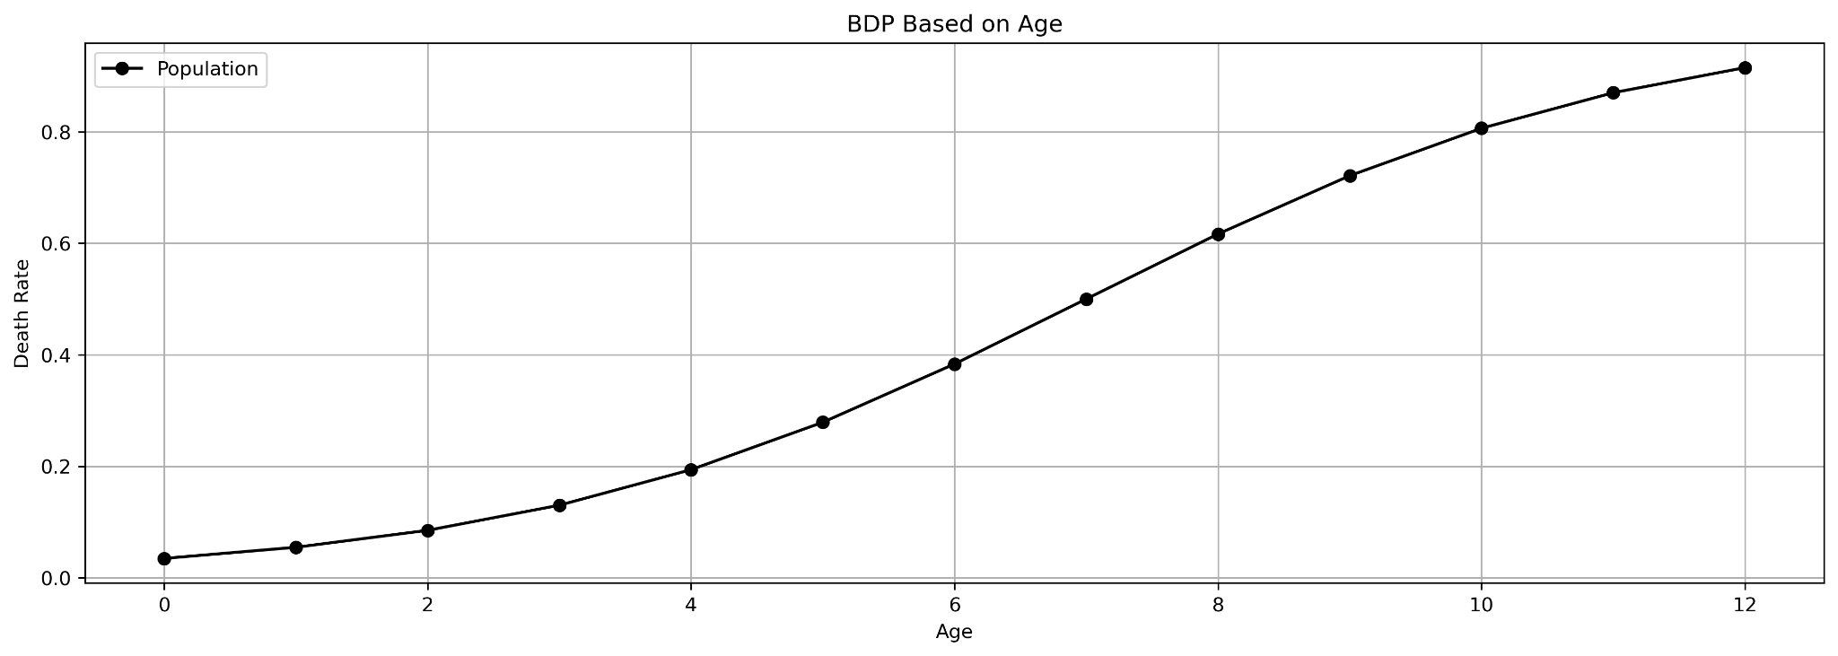
Population Simulations - Base Death Probability
BDP = (1 / (1 + np.exp(-0.1 * (age - average_lifespan)))
BDP = (1 / (1 + np.exp(-0.9 * (age - average_lifespan)))
BDP = (1 / (1 + np.exp(-0.4 * (age - average_lifespan)))

Slide 14
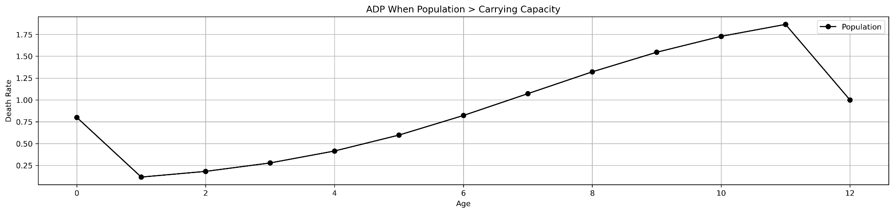
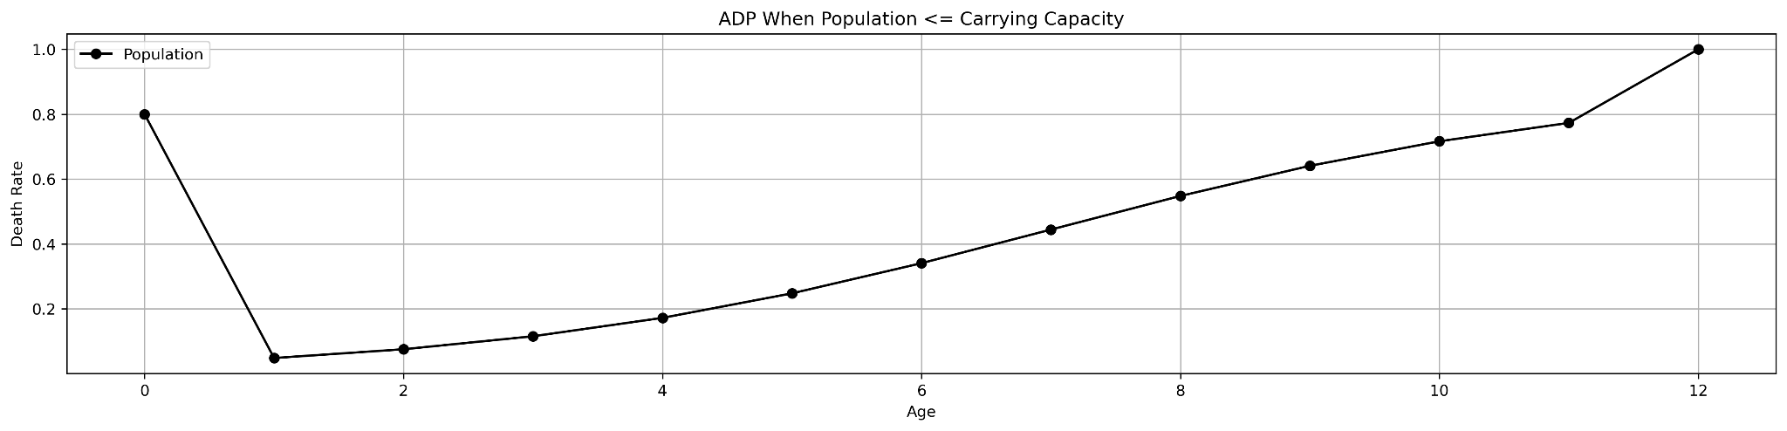
Population Simulations - Adjusted Death Probability
ADP = BDP * (2 * ((popSize / carrying_capacity) ** 2))
ADP = BDP * (2 * ((popSize / carrying_capacity) ** 0.1))

Slide 15
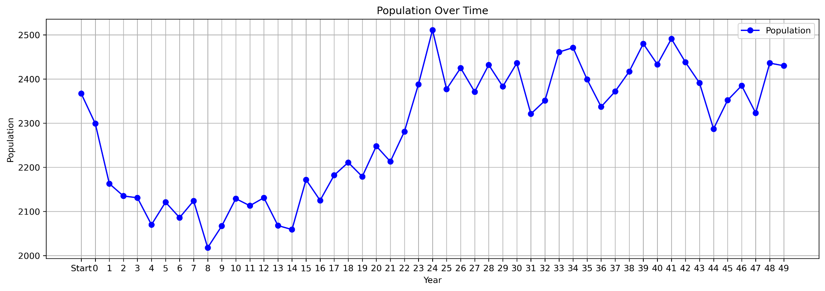
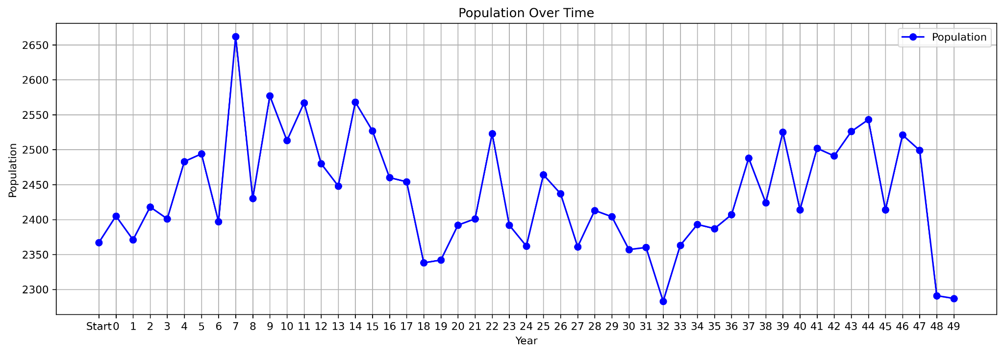
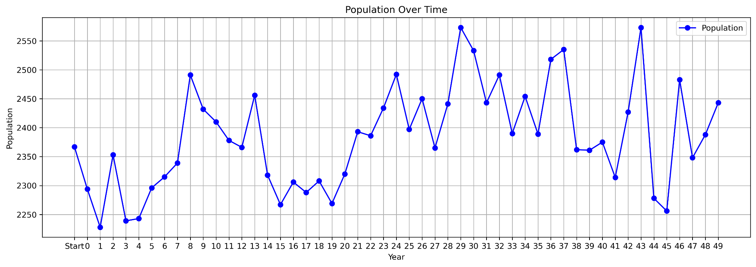
Population Simulations
Simulation 1
BDP = (1 / (1 + np.exp(-0.45 * (age - average_lifespan))) + random.uniform(-BDP,BDP)

Slide 16
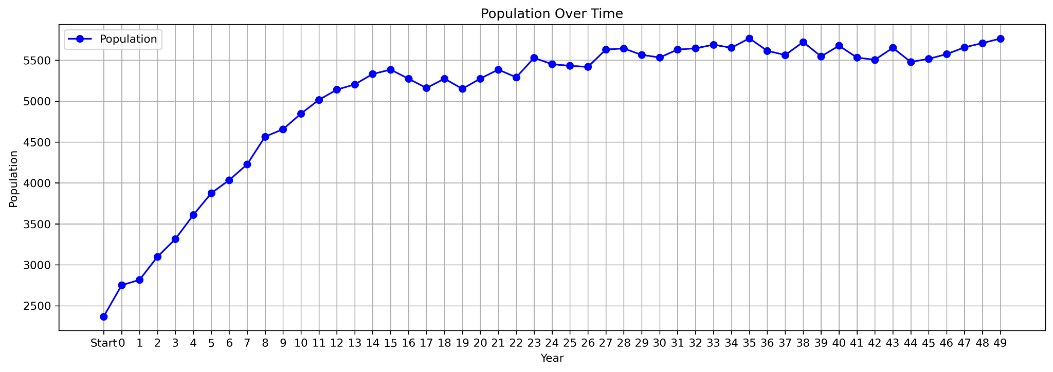
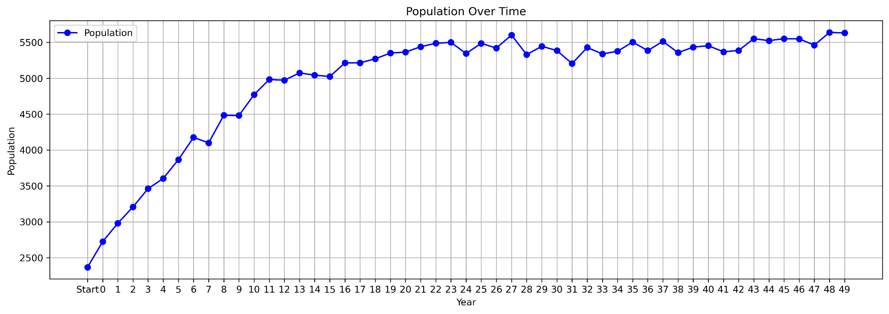
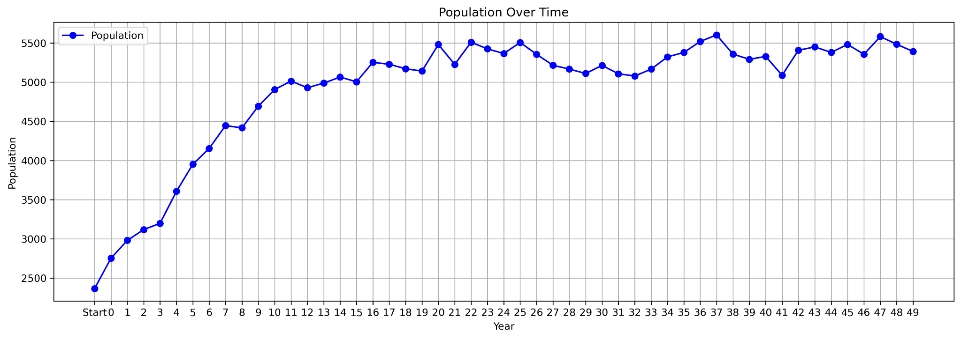
Population Simulations
Simulation 2
BDP = (1 / (1 + np.exp(-0.9 * (age - average_lifespan))) + random.uniform(-BDP,BDP)

Slide 17
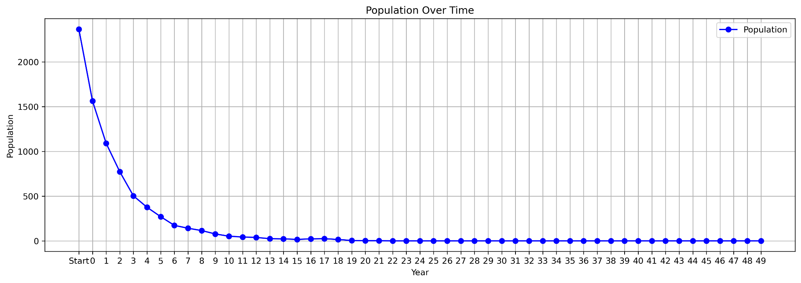

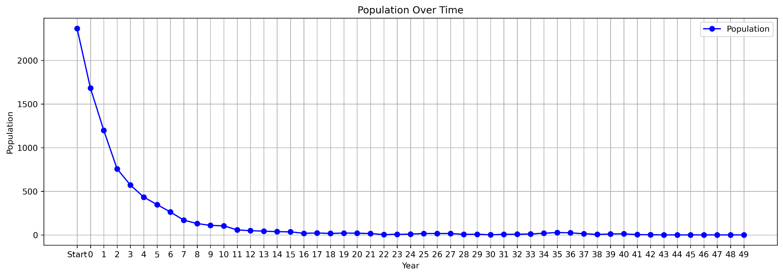
Population Simulations
Simulation 3
BDP = (1 / (1 + np.exp(-0.1 * (age - average_lifespan))) + random.uniform(-BDP,BDP)

Slide 18
Steps Forward
Create a Spatial Decision Model to move each individual
Model with changes over time annually (likely with monthly precipitation, temperature, and NDVI)
Add food/shelter to model (Ponderosa Pine and precipitation most likely) for more defined decisions of individuals

Slide 19


